Slide 1
WELCOME Holy Family Catholic Primary School Annual Coffee Meeting

Slide 2
Partners
I dreamed I stood in a studio, And watched two sculptors there. The clay they used was a child's mind, And they fashioned it with care.
One was a teacher; the tools used, Were books and music and art. One, a parent with guiding hands, A gentle and loving heart.
Day after day the teacher toiled, With a touch both deft and skilled. The parent laboured side by side, And all the values filled.
And when at last their task was done, They looked at what they'd wrought. The beautiful shape of the precious child, Could neither be sold nor bought.
And each agreed it would have failed, If one had worked alone. For behind the parent stood the school, And behind the teacher, home.

Slide 3
At Holy Family School we will provide a secure and happy environment in which we will :-

Slide 4
Pray together:
Through our family and community of faith we strive for all to hear the message of God.
Through the promotion of the Christian values of love, acceptance and respect for all, we will provide opportunities for all to develop an awareness of God’s presence in themselves and in others.
Through the teachings and practice of our faith we will provide opportunities to respond to the word of God through collective worship, celebration and quiet reflection.

Slide 5
Play together:
Through the development of excellent relationships in our school community we will strive to ensure all experience mutual respect, acceptance and love.
Through fun filled activities, projects and social events we will provide opportunities to promote community cohesion and togetherness.
Through our creative curriculum we will strive for all to seek excellence and experience enjoyment.

Slide 6
Learn together:
Through the provision of a stimulating, well-balanced, forward thinking, diverse curriculum we will provide opportunities for all to develop an awareness of themselves, others and the world in which we live.
Through inspirational, innovative, holistic teaching we will seek to create learners who aspire to succeed.
Through the promotion of learning and equality for all we will strive to create independent, lifelong learners.

Slide 7
In fulfilling our Mission Statement we aim to:
Acknowledge our responsibility to support parents in their task of nurturing their children towards human wholeness within a Christian community

Slide 8
School:
We will:
Provide you with information about your child’s progress and provide you with opportunities to talk to teachers.
Keep you well informed about school policies and activities through regular letters and newsletters.
Set, mark and monitor homework suitable to your child’s needs.
Send home an annual report of your child’s progress.
Contact you if there is a problem with your child’s punctuality or attendance.
Inform you of any concerns regarding your child’s behaviour, work or health.
Challenge your child to strive for the highest standard of personal, social and intellectual development and aim for excellence in all they do.

Slide 9
Parents: We acknowledge that we as parents are the primary educators of our children and have an irreplaceable role to play in supporting our children’s learning at school.…
I will:
See that my child attends school regularly, on time and suitably equipped.
Inform the school of any concerns or problems that might affect my child’s work or behaviour.
Support the Christian values of the school community.
Give my child opportunities for home learning and support home learning and homework from school.
Support the school’s policies and guidelines for behaviour.

Slide 10
Parents:
I will:
Attend parents’ evenings and discussions about my child’s progress.
Encourage my child to be enthusiastic about learning and to enjoy school.
Encourage my child to show kindness and consideration to others.
Talk to my child about their experiences in school and encourage them to do their best.
Attempt to support the Catholic community and the school governors in their responsibilities for maintaining the school buildings in good repair.

Slide 11
Pupils: I acknowledge the different and unique talents which God has given me and my responsibility to use them wisely.
I will:
Attend school regularly and on time.
Wear the school uniform and bring all the equipment I need every day.
Take care of school equipment and help keep our school and community free from litter.
Learn something new each lesson and always do my best.
Share my feelings honestly and politely and show consideration for others in school and the surrounding community.
Behave sensibly so we can be happy and safe as we learn.
Try to think for myself and take responsibility for my actions.
Observe school rules and treat everyone with the respect they deserve.

Slide 12
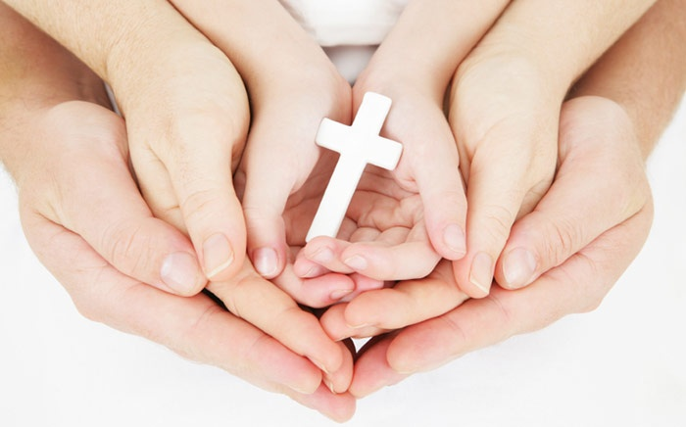
Our school prayer
Jesus, Mary and Joseph bless my family at home,
Jesus, Mary and Joseph bless my family at school,
Jesus, Mary and Joseph bless all the families of the world.
Amen

Slide 13
Our School Mission Statement
Following in Jesus’ footsteps…
We pray together
We play together
We learn together

Slide 14
Welcome Letter
Uniform
Homework
Punctuality and Attendance
Behaviour and School values
Taking Pride in Their Work
Praising and Rewarding
PE
Dinner Money
Questions and Appointments
Medicines
Communications

Slide 15
Key Stage 2 (Year 6)SATs Results 2017
In 2017, our results at the expected standard were not as high as in previous years, however, the percentage of children attaining at the higher standard had increased.
In 2017, 29% of our children in Year 6 last year had special educational needs with two children not sitting the SATs tests. These two children still count in the percentages achieved by all children.
Reading 74% at expected and 32% at greater depth standard.
Writing 74% at expected and 32% at greater depth
Maths 81% and 23% at greater depth standard.
Notes:
Given the pressures of a new and more challenging curriculum and revised assessments our children performed exceptionally well with our school performing top in Knowsley at both Key Stage 1 and Key Stage 2 and well above national averages.

Slide 16
We are currently looking at the support for our children with SEN to ensure the best possible progress for these children.
Whilst attainment for our girls overall is high, their progress is not as high as it could be, particularly for maths.
Both these areas will be a major focus in our school improvement plan.

Slide 17
Year One Coffee Morning

Slide 18
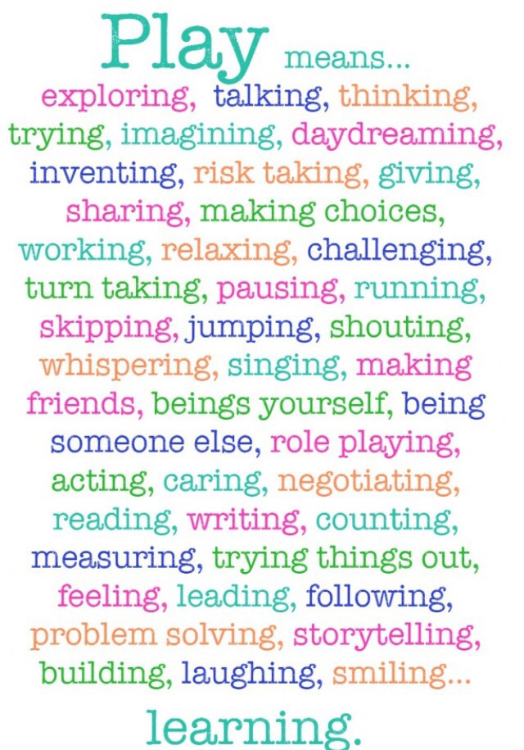
Our approach to learning in R/Y1

Slide 19
Our approach to learning in R/Y1
Autumn/Spring Term –
Play based learning in Continuous Provision
Summer Term - Increased adult directed learning time

Slide 20
Our Routine
9.00 – English 9.30 – 9.40– Handwriting/Physical Development
9.40-11.00-Continuous Provision/Guided read 11.15– 11.40 – Letters and Sounds
11.40 – Lunchtime
1.00 – Maths
1.30 – 2.40 – Continuous Provision/Maths groups
2.40 – 3.10 – Come and See/Topic

Slide 21
Stories and Poems
Books - Harry and his Bucketful of Dinosaurs, The Snow Queen, The Little Red Hen, Billy Goats Gruff to name but a few!
Class Author - Oliver Jeffers
Poets - Michael Rosen, Roger McGough, Roald Dahl

Slide 22
Letters and Sounds
Phase 3 recap - till Jan/Feb
Phase 4 Feb till Easter
Phase 5 till July
Phase 5 in Y2

Slide 23
Maths
Focus in the Provision
Progressive across the year building on understanding and skills.
Fluency, problem solving and reasoning
The term ‘mastery’
Concrete, Pictorial and Abstract

Slide 24
Finger Writing (Physical Development) & Handwriting

Slide 25
Praise and Rewards
- The Minions
Shakespeare
Achievement assembly certificates
Values board

Slide 26
PE –Tuesday morning and Wednesday afternoons

Slide 27
Homework
H
Homework will be given out on a Monday
Very practical activity
Learning Story to be sent in by Friday- please ensure this is sent in as evidence

Slide 28
Uniform/PE Kits
Wellies

Slide 29
Dinner Menus
- Given out previous week
- Please complete with your child to ensure they are making a choice about their meals
- Please return asap
Thank you

Slide 30
Documenting learning
Tapestry
Observations parent shared every two weeks!

Slide 31
Questions

Slide 32
Thank you for coming! ☺ x

