Slide 1
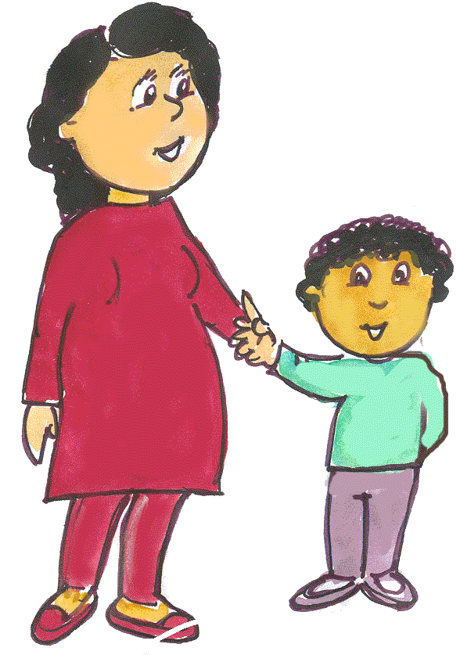
Your first language is important
Pupil, School and Family Service
Speech and Language
with
Support for Ethnic Minority Achievement
Session One
Sponsored by the Neighbourhood Renewal Fund
Notes:
A lot of people think that when a child who doesn’t speak English come into nursery or school that they will start to speak English easily. This might be true for older children who can speak their first language well.
It is important that young children have firm foundations in their first language in order to develop a second language well.
When they have this, children will talk confidently and will be ready to learn English.

Slide 2
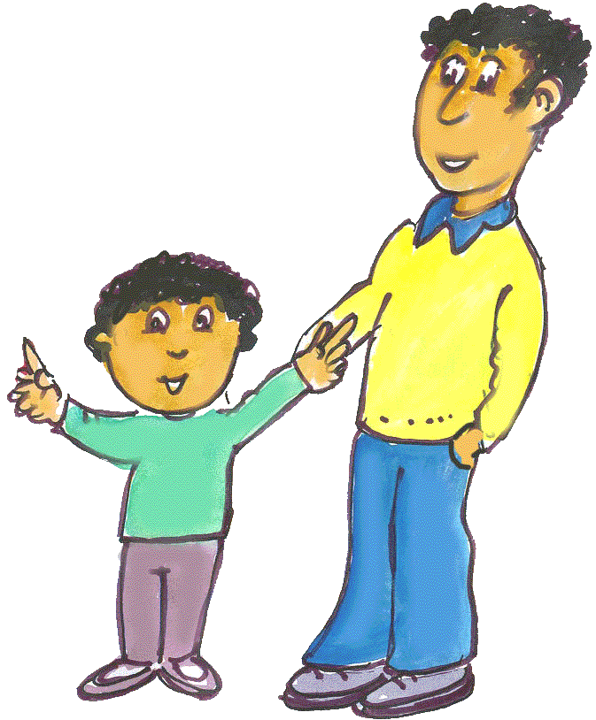

As a parent you are your child’s first teacher
PSFS and SEMA
Notes:
All they have learnt about the world is from you, your home, your community and your life – and they’ve done it all in your strongest language we’ll talk about that in a minute
There is a critical time in a child’s life to develop language – from birth to 7 years – and for the majority of that time, they are with you.

Slide 3

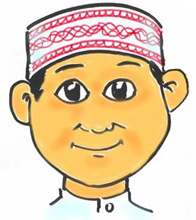
Your home language is very important to your child’s development
PSFS and SEMA
Notes:
Your child’s first language is important and should be valued as it is a big part of who they are; their identity and it forms the understanding of the world around them.
It is good for children to hear different languages, but it is better for the child that you and other family members talk regularly to the child in the language that you know best.
Your strongest language is the one you speak and understand best of all.
Tell your child the name of the language that you use.
All the research tells us that if you have a firm foundation of one language it is easier to learn more languages. Try to build up a rich vocabulary – lots and lots of words & different words for the same thing/ slightly different meanings all within good sentences.
Give the example of trying to learn how to tell the time without knowing the essential vocabulary first – o’clock, half past etc – Catherine in Italian!!!!

Slide 4
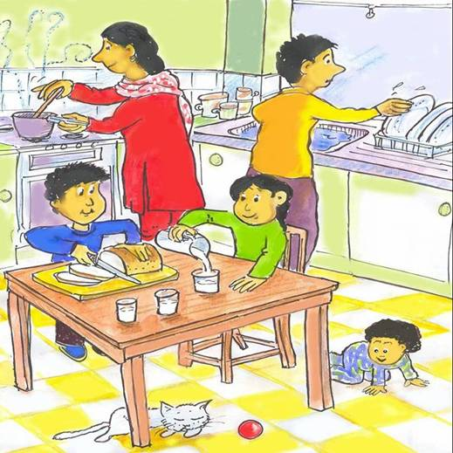
Comment on the everyday things you are doing
PSFS and SEMA
Notes:
In the early stages children learn by watching and copying what they see and hear.
In most cases, the more they see and hear, the quicker they are going to learn and after awhile they will start to try and copy.
LOOK at the picture
What could the big sister be saying? Questions
By talking about everyday things in your strongest language you are giving your children a very good start in life and learning about everyday things.
Talking to your child can easily fit into your daily routine – chat about the things you are doing in the kitchen, at home on visits and with family
DVD clip ‘Getting Children Talking’ - Scene Selection – Part 2 ‘Your Child needs time to listen and to talk’ Title 3 Chapter 5 to 05:40 (African, Chinese and English)

Slide 5
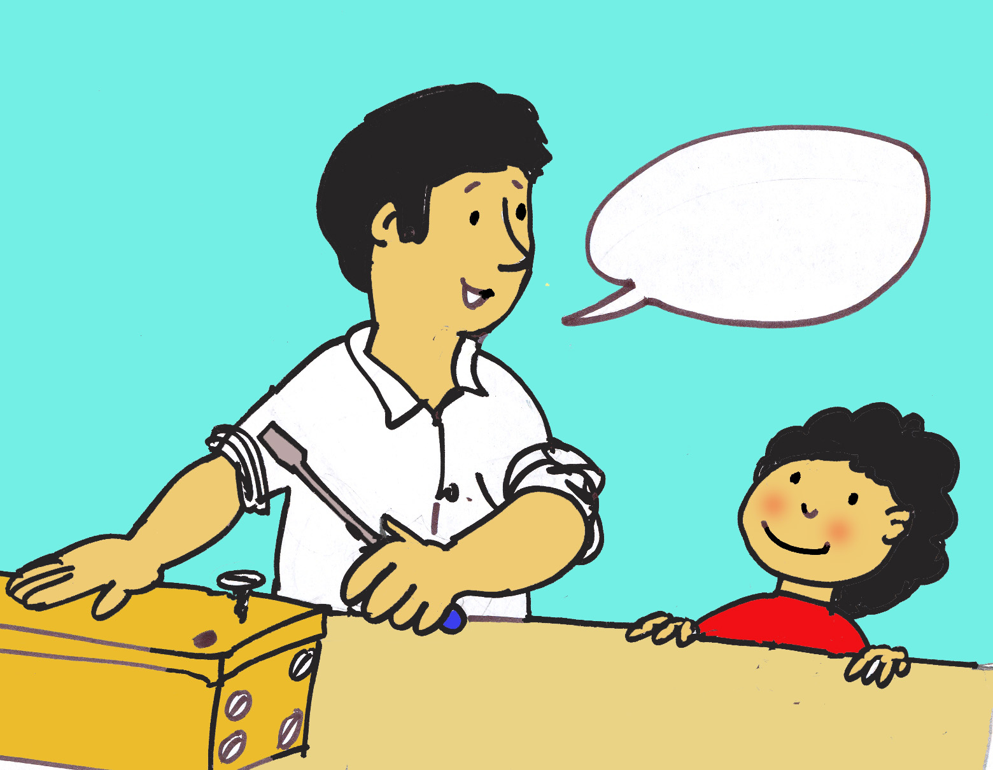
By asking too many questions you can slow down a child’s language development.
Now it’s time to put the screw in.
PSFS and SEMA
Notes:
The last clip was called ‘Your child needs time to listen and talk’ – this is because by asking too many questions you can slow down a child’s development.
In order to get a child to be a good communicator is like baking a cake; you have to put lots of good ingredients in, carefully mix and allow time to bake. In this time the child is taking everything in, absorbing ideas and words, gestures and then next step show you that they understand
Its never too early to start talking to your child – talking and listening to children from the moment they are born helps them develop good language and communication skills.
Try not to ask your child too many questions – instead tell them about things, especially the things they show an interest in, like a favourite toy.
A child first word has taken nearly 2 years of watching and listening – that’s the icing on the cake is when the child speaks/responds - the child cannot answer questions until they have enough expressive language language/or knows the words/can say the words. LOTS LOTS LOTS of input first –

Slide 6
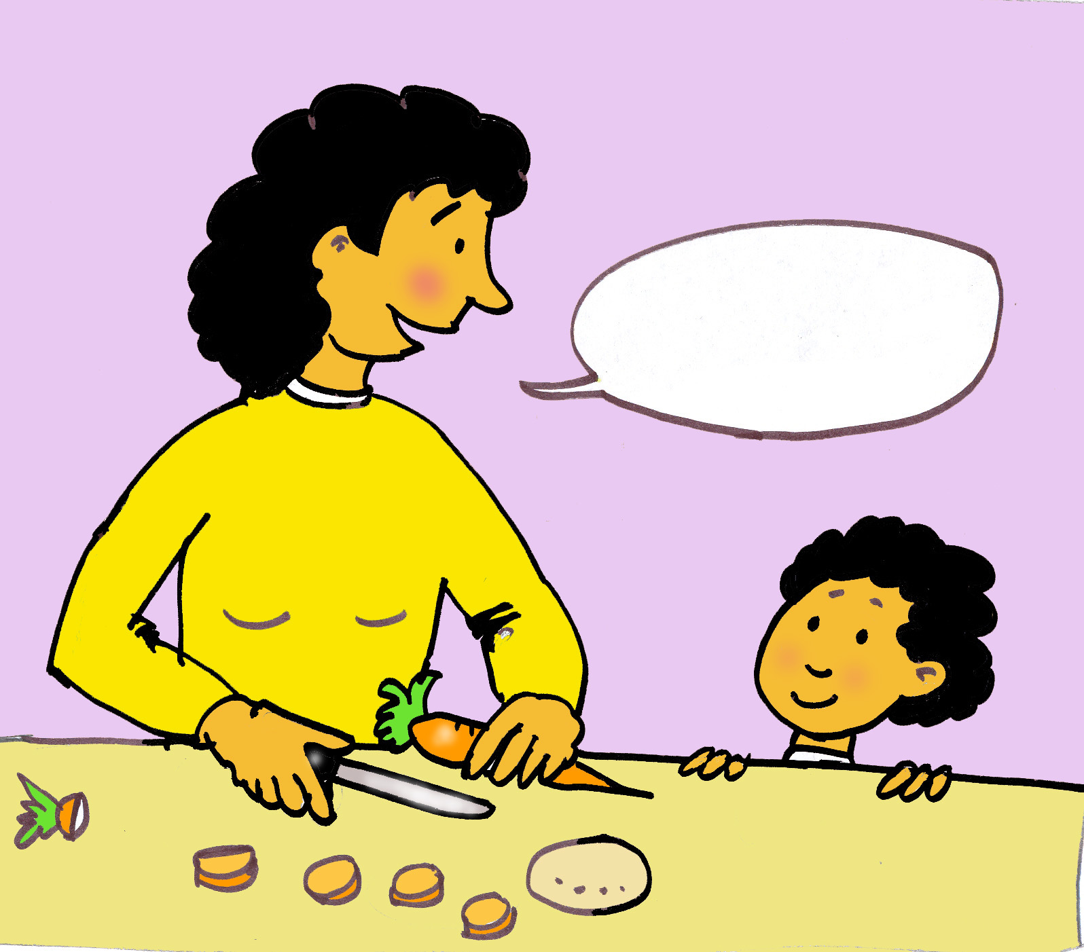
Help get ready for school
I’m chopping this carrot into big pieces.
PSFS and SEMA
Notes:
When your child starts school or nursery they have to start learning special words and what they mean e.g. maths, science, geog words.
It will really help if you can help them understand the meaning of the words in your strongest home language e.g. picture – and then it will be easier to learn these words in English.
Don’t be frightened about talking /using maths/science words – you can do this in your everyday life – remember the video clip of the Chinese baby playing with her mum –’round and round + round was mathematical up + down positional vocabulary.
You can do this.
It is the best thing you can do is to build up your child’s vocabulary.
Vocabulary can be seen as a prediction for further educational success – Recent research shows 5,000 words @ reception stage (irrespective of which language) good indicator of academic achievement

Slide 7
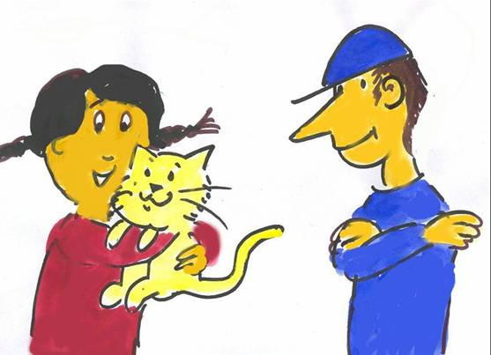

Talking to your baby in your own language
www.talktoyourbaby.org.uk
PSFS and SEMA
Notes:
3 handouts from the web site – this web site is for parents just like yourselves – lots of ideas and information for you to use.
On the back of every handout – 6 key points from what we’ve tried to say
DVD clip ‘Getting Children Talking’ Part 2 ‘Your child needs time to listen and talk’ Chapter 3 up to 02;22’ish (grapes and apples)
White handout ‘The importance of first language’ is a summary of what we have said and please take one and talk to our translators.

